Slide 1
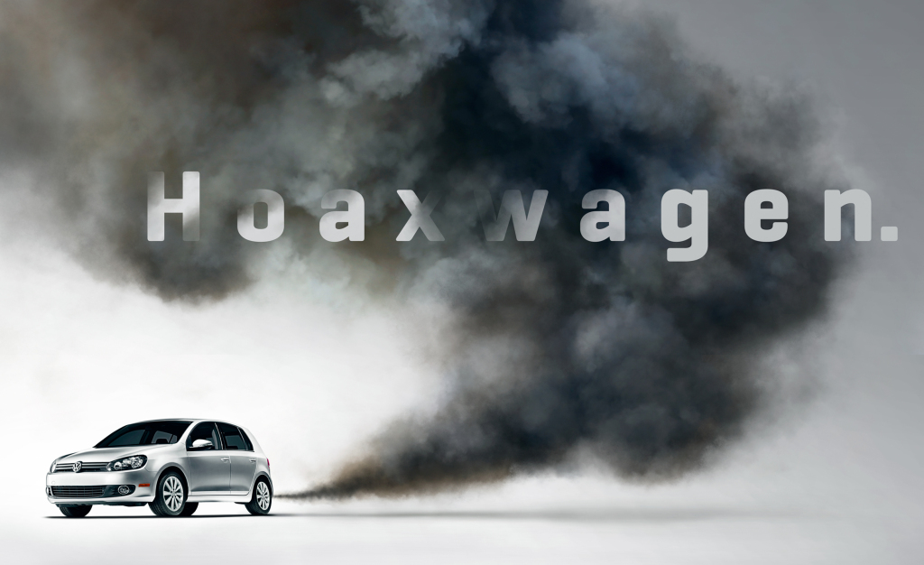
CASE STUDY
VOLKSWAGEN POLLUTION
SCANDAL
-: TEAM RAW :-
AGENT RINKAL
AGENT AJINKYA

Slide 2
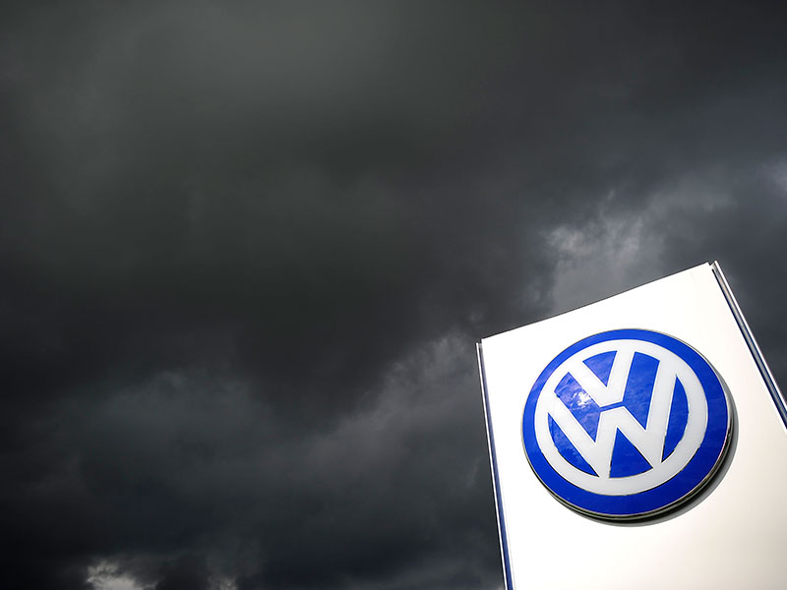
WHAT IS VOLKSWAGEN

Slide 3
WHAT WAS THE CASE

Slide 4
REASON BEHIND CASE

Slide 5
EFFECTS OF CASE

Slide 6
FURTHER STEPS BY VOLKSWAGEN

Slide 7
HOW TO HANDLE CRISIS

Slide 8
STEPS TO AVOID FURTHER CRISIS

Slide 9
HOW TO ADVERTISE COMPANY AGAIN

Slide 10
!!! THANK YOU !!!

